Slide 1
Parameter guidelines for fingerprinting relational data
Jan 11 2022

Slide 2
Motivation
Lack of evaluation guidelines or parameter choice guidelines
The robustness and data utility are affected by fingerprint parameters and data, therefore we cannot generalise the trends for any possible data set
Solving the trade-off of robustness and utility – the „subjective“ decision of a data holder can be done in an informed way

Slide 3
Contributions
Evaluation-based guidelines for choosing scheme parameters
Data utility aspect (data statistics and task-oriented metrics)
Robustness aspect (robustness against attacks)
Cost of attacks
attacking is no free lunch for the attacker because with the malicious modifications, the utility of the data changes as well
Can be used as a lower boundary for robustness
High-level quality measure for a fingerprint scheme (i.e. parameter setting)
Allows ranking the parameter space for the user to be able to choose optimal
Adjustable by user‘s preferences (i.e. increasing the weights on data utility over robustness)
Presentation of risks and quality properties for parameter settings
Can be constrained by the user, e.g. limit the estimated utility loss

Slide 4
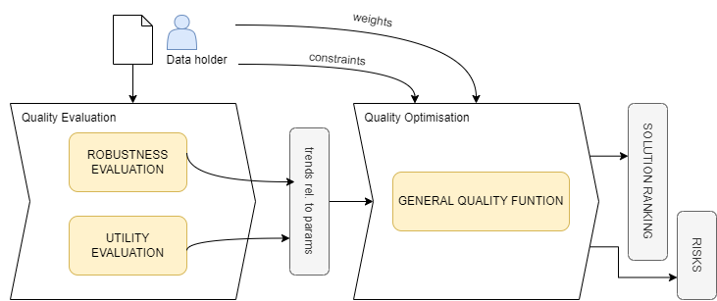
Guideline process

Slide 5
Quality evaluation
ROBUSTNESS – answers questions such as:
If data is fingerprinted with a particular parameter setting P, how many rows at most can the attacker delete while not affecting the fingerprint?
Which parameters are affecting robustness of the fingerprinit the most?
What type of attack damages the fingerprint the most?
UTILITY
Data statistics
Task-oriented measures

Slide 6
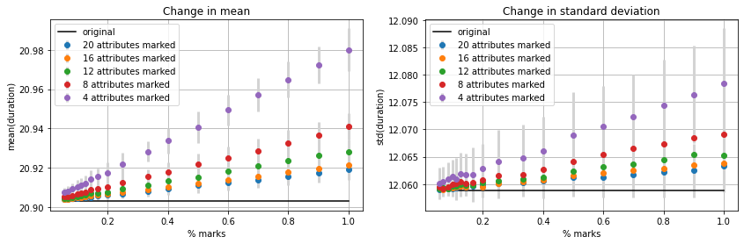
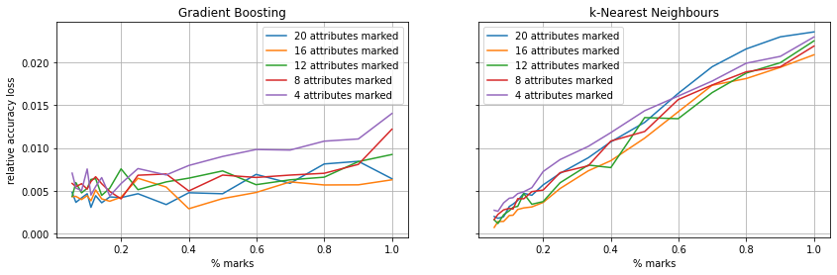
Quality evaluation – result demo

Slide 7
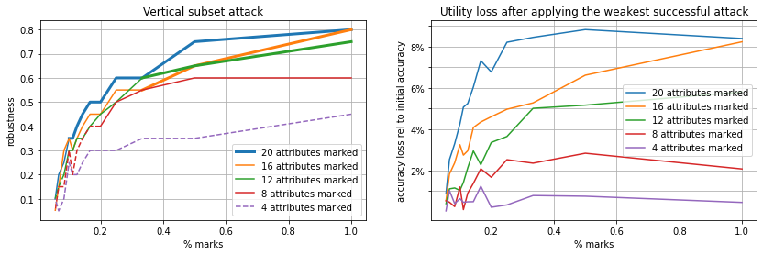
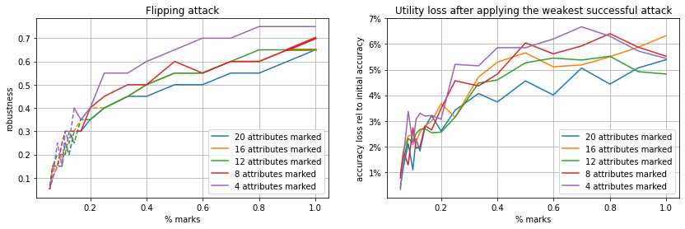
Quality evaluation – result demo

Slide 8
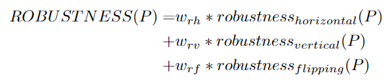
Overall quality optimisation
General Quality Function
captures all evaluated aspects
Adjustable weights
Quality constraints
Max performance loss, max change in mean, …
Min robustness against horizontal attack, …

Slide 9
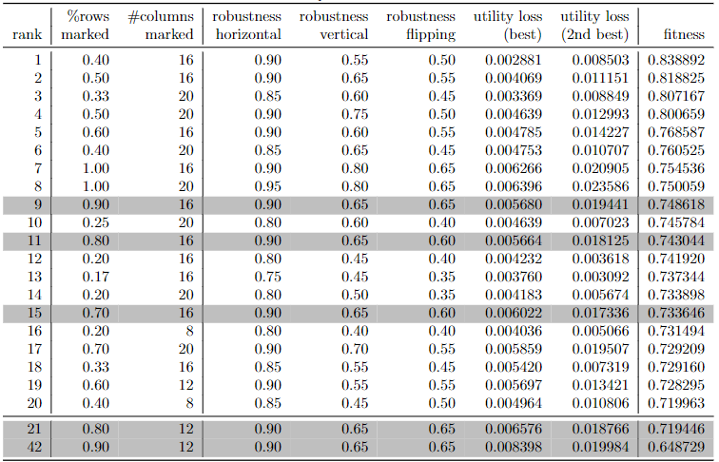
Overall quality optimisation – result demo
Top 20 solutions according to the General Quality Function

Slide 10
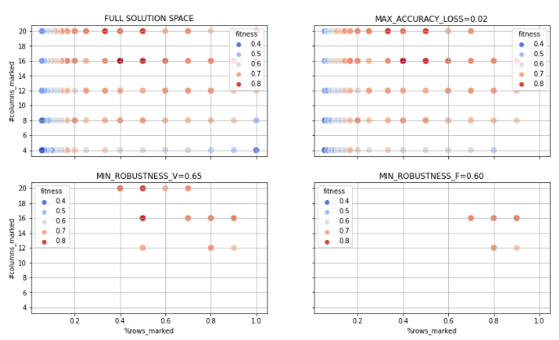
Overall quality optimisation – result demo
Solution space
Applying constraints

Slide 11
Parameter choice and associated quality properties
More than 90% of data rows need to be deleted to remove the fingerprint. (The attacker loses at least 14% on classification accuracy (reads from the robustness plots))
More than 65% of data columns need to be deleted to remove the fp. (The attacker loses at least 8% on classification accuracy)
More than 65% of data values need to be modified to remove the fingerprint (the attacker with this loses at least 5% on classification accuracy)
The data is expected to decrease the acc of the best performing classifier by 0.568% rel to the acc on original data, (i.e. Gradient Boosting is expected to have acc around 76.36%)
The second best has 1.94% decrease in accuracy, (i.e. kNN is expected to be 74.53% accurate )

